Slide 1
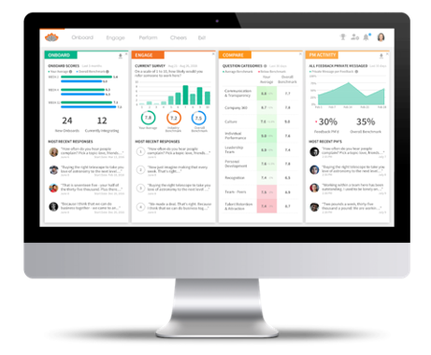
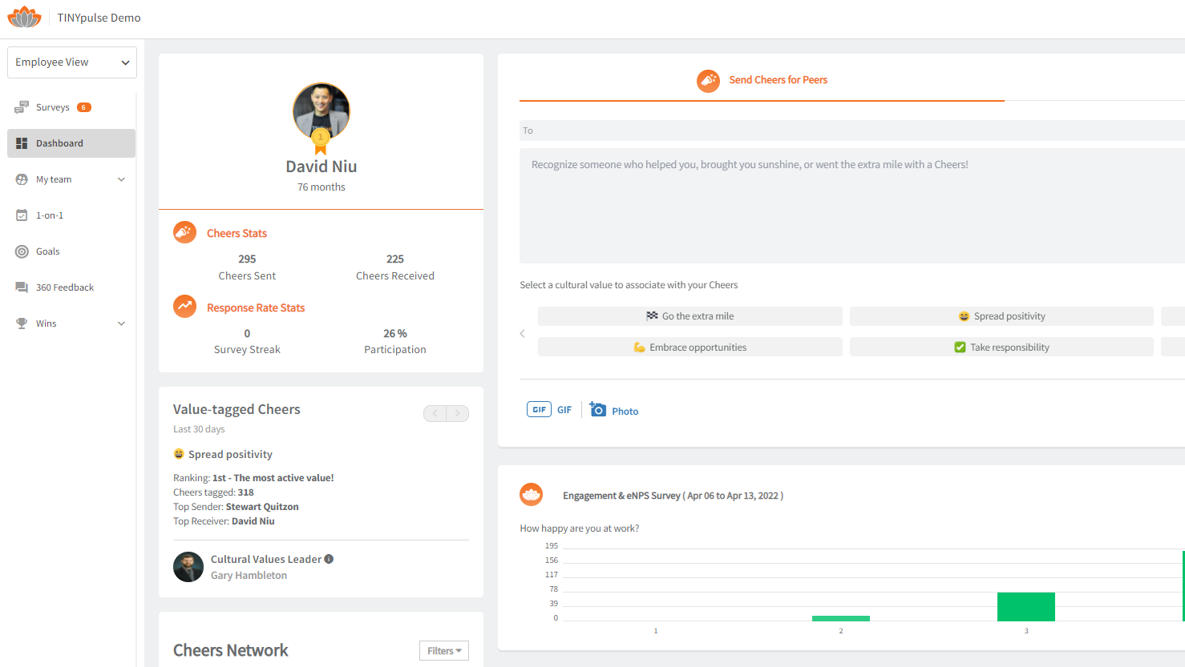
Feel heard. See change. Feel Valued.
Take part in TINYpulse by Limeade surveys to impact your experience at work in a positive way!
TINYpulse by Limeade streamlines your internal communication to build trust between employees and management for a culture of transparency and accountability.
1

Slide 2
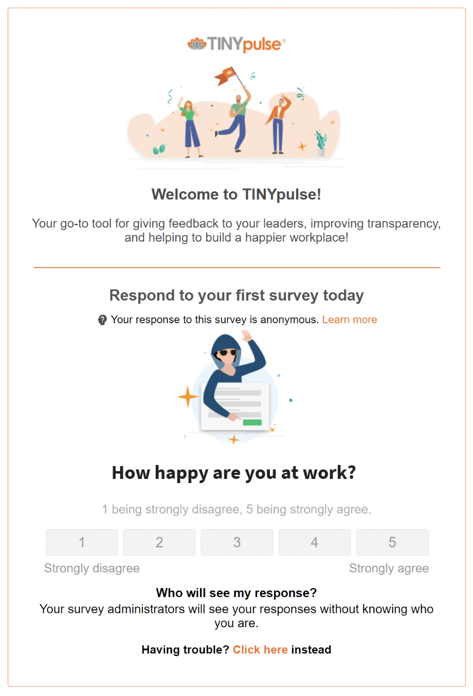
Welcome to TINYpulse!
Our mission is to help build cultures where people flourish. Here’s what you can do with TINYpulse:
Surveys: Provide your insight into important organization surveys and initiatives. The most fundamental component of TINYpulse for employees is responding to your TINYpulse survey. Giving regular feedback is a critical component to a happy and transparent workplace.
Suggestions: Share your Ideas and Solutions
Suggestions are a great way to give your anonymous feedback to administrators about anything and everything. You receive regular surveys requesting your thoughts on anything from your organization's recognition programs to mentorship, but what if you have a concern and solution to improve safety in your workplace?
Cheers: Spread Positivity
Send Cheers for Peers to your coworkers that have gone above and beyond. Recognize their contributions and anniversaries.
2

Slide 3
Employee View - Dashboard
Cheers For Peers: Send peer to peer recognition, attach a gif or value tag.
Surveys: All active surveys for the employee.
Suggestions: Send anonymous feedback through the virtual suggestion box.
Coach Tools: Access employee 1-on-1s, goals, and 360 Feedback. *Managers use “My Team” to view their team’s Coach data.
Wins: View the Wins Board and Wall of Wins.
3

Slide 4
What to expect:
INSERT ORGANIZATION HERE will be launching your first TINYpulse survey on INSERT DATE HERE.
1
2
3
Login & Survey Instructions
Launch Date Login
& Account Creation
Submit your Anonymous
Survey Results
You will be receiving further instructions from your Admin team via email. *Read the instruction email in full* This will include details related to:
How to Create an Account.
How to submit your survey responses.
Additional resources to familiarize yourself with TINYpulse.
If your company has enabled SMS, how to download the TINYpulse Mobile app
If your company has configured a Slack or Teams integration, send Cheers and Suggestions without having to send an email.
INSERT DATE HERE on INSERT TIME HERE you will receive your first TINYpulse Survey via email. This will prompt you to set your account login.
Once logged into TINYpulse you will be able to navigate in your TINYpulse Dashboard.
The Survey will be available to you to submit your anonymous response.
4

Slide 5
Thank you!
© 2022 TINYpulse by Limeade – All rights reserved.
Confidential materials, not to be shared without permission.
5

