Slide 1
Fundamentals of Employee Well-Being
TinyWebinar
September 23, 2021
Jessi Crast, PhD
Researcher
Limeade Institute

Slide 2
Meeting Agenda
Whole Person Well-Being
Organizational Support
Org Support for Well-Being
Recommendations
Q&A

Slide 3
Whole Person Well-Being
What happens in one part of one’s life affects other areas
(emotional, physical, financial, work…)
3
Notes:
At Limeade, our mission is to transform work into a source of positivity, energy, humanity and purpose. We want to infuse well-being into the employee experience.

Slide 4
Why Whole Person Well-Being Matters
It is all inter-related
47%
of employees say problems in their personal
lives affect their performance
(Bensinger et al., 2013)
37%
of HR professionals agree, employees miss work due to financial emergencies (SHRM, 2014)
50%
Of all illness in the US has stress has a contributor (U.S. Department of Health and Human Services, 2000)

Slide 5
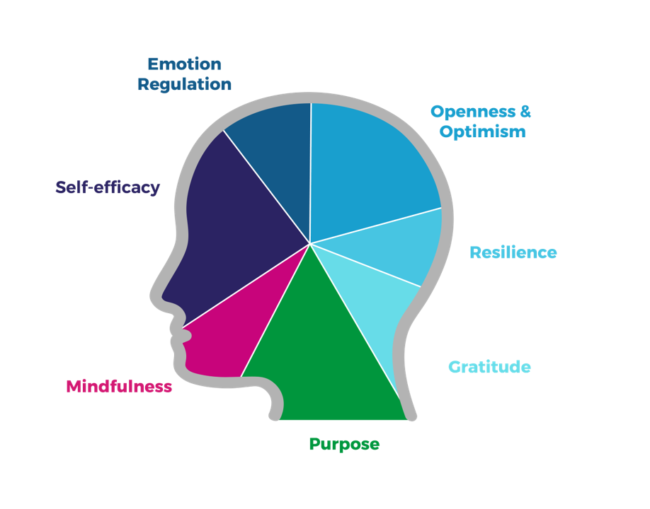
Well-Being Influencers
Behaviors, attitudes, and emotions
Mindsets that can generate energy and expand our capacity to improve overall experiences and quality of life.
Can be influenced by one’s company

Slide 6
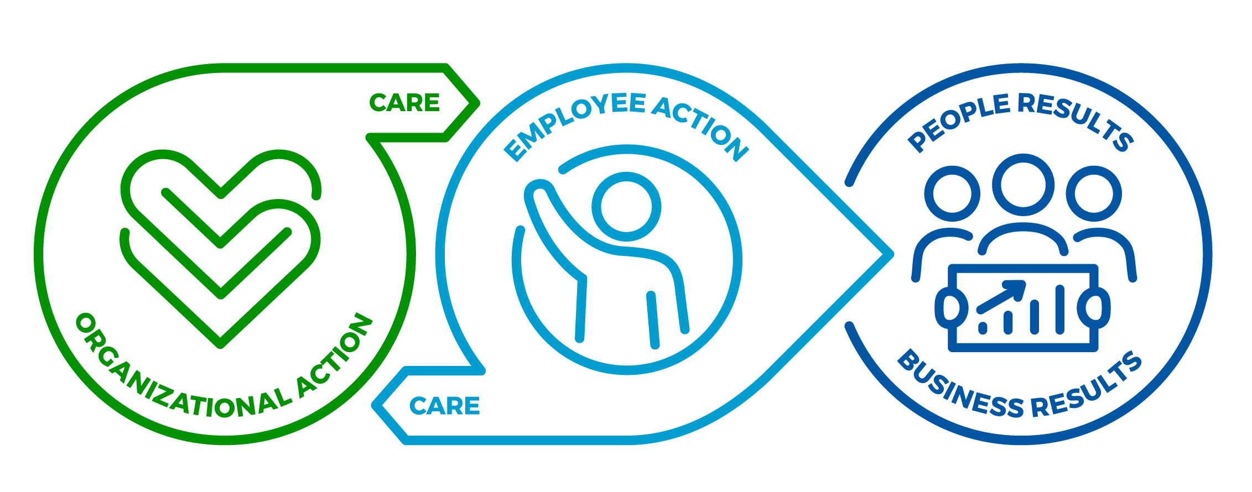
Limeade Results Model
When companies care for employees — in every part of the employee experience — employees can better care for themselves, their teams and their company, leading to better people and business results.
Managers
Teams & Peers
Networks Environment
Tools & Programs
Leaders
Strategic Alignment
Culture
Awareness Mindset Motivation & Intention
Behavior Social Connection
Resource/Support Utilization
Turnover
Engagement
Well-Being Inclusion
Profit​ Customer Sat
Innovation Other Financial Results
6
Notes:
The Limeade Results model demonstrates how companies can help kickstart a cycle of care and commitment between the company and its employees.
Together, this mutual commitment helps drive positive people results and improve business results.

Slide 7
Company Care
care /ker/
noun the provision of what is necessary for the health, welfare, maintenance, and protection of someone or something
verb look after and provide for the needs of
7
Notes:
The way we operationalize “CARE” into tangible action is through the theory of Organizational Support, which is really all about providing for needs in a work setting.

Slide 8
Organizational Support Theory
Informed by Social Exchange theory & Attachment theory
→ Fulfillment of socio-emotional needs (e.g., approval, belonging)
Positive emotional attachment
Organization has positive intent
Organization cares about me and my well-being
Mutual commitment
8
Notes:
According to the theory, employees develop a more favorable orientation toward their organization in response to the organization’s fulfillment of their socio-emotional needs (e.g., approval, esteem, affiliation and emotional support) and material goals and objectives.
The organization’s sets policies and practices that become part of the culture – the culture reflects its values and priorities. This in turn guides the behavior of the employees, especially leadership and managers.
Consequently, employees tend to see human-like characteristics in their company. This perspective creates a needs fulfillment process, where employees expect organizations to fulfill certain needs – when these needs are met, it leads employees to feel a greater sense of attachment and affiliation to the organization – people assume the organization has a positive intent toward them, cares about them, and this sets off a cycle of mutual commitment.

Slide 9
Elements of Organizational Support
Trust
(Two-way)
Commu-nication
Support
Investment
Value
CARE
9
Notes:
What are the needs that companies should be providing for employees?
2020 Limeade Institute Study on Caring Cultures:
One of the top 5 most commonly reported responses was that Care feels like support (underscoring why we operationalize Care as Organizational Support).
Showing that employees are valued for their unique contributions they bring to their job
Investing in employees by providing growth plans, learning opportunities, etc.
Two-way trust – showing employees they are trusted and earning trust in the leadership of the company
Communicating information clearly and frequently to keep people informed about what’s going on at the company,
This includes company’s goals/mission and their role in it. A big driver of people’s engagement with their work comes from understanding the bigger picture and how their work contributes to it.

Slide 10
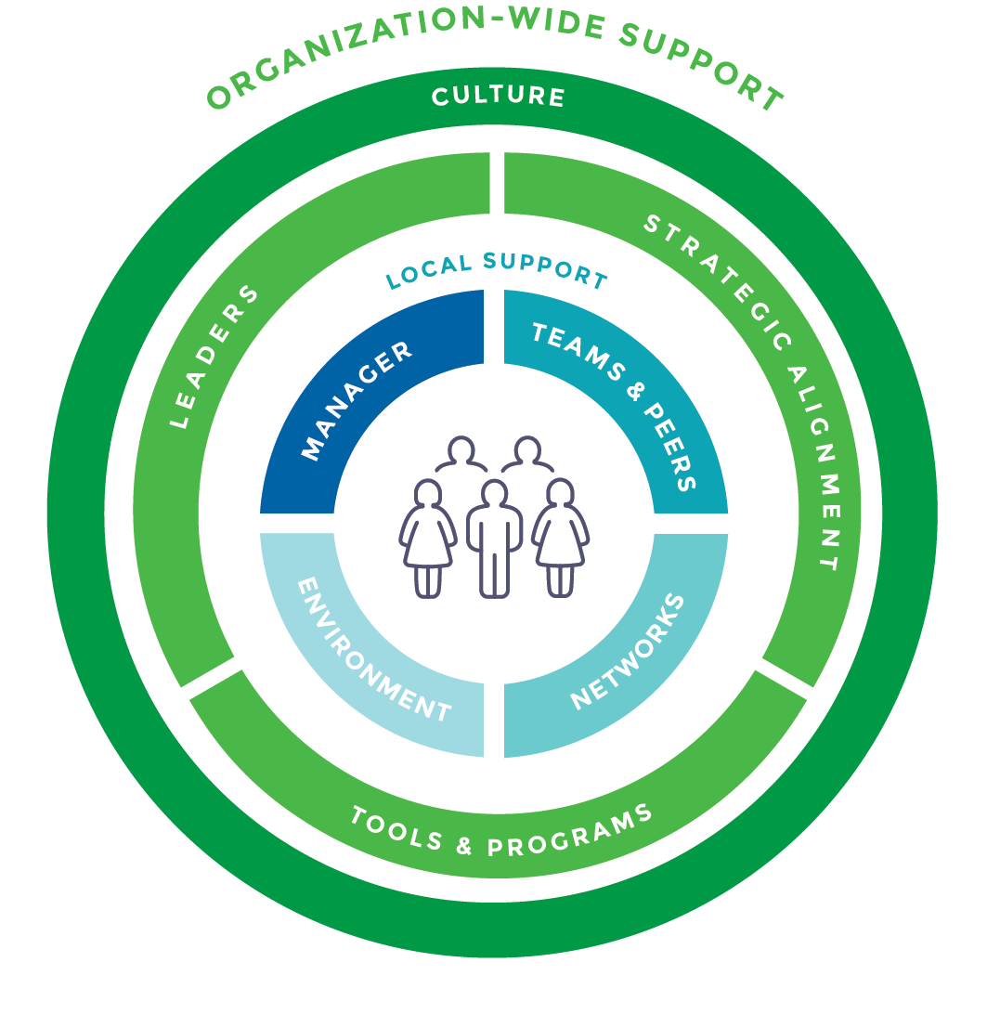
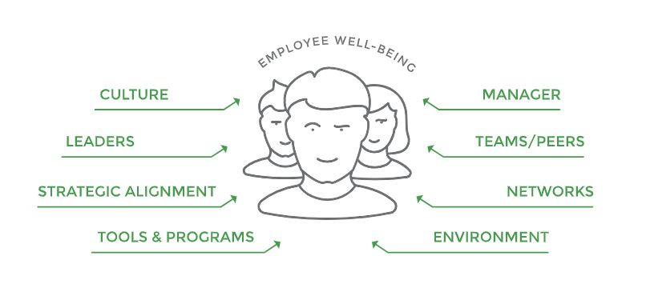
Sources of Organizational Support
Notes:
Organizational support model: we took all the inputs shown on the left and re-arranged them to show the whole ecosystem of support in terms of direct and indirect influences on employees.

Slide 11
11

Slide 12
The Importance of Organizational Support for Well-Being
It is all
inter-related!
12
Notes:
When org support is high, employees report better well-being in their lives overall – it’s all interconnected.

Slide 13
Organizational Support for Well-Being
99%
91%
When employees feel their employer cares about their well-being, they’re
who feel they have higher well-being and org support recommend their company as great place to work
employees with high well-being and org support are less likely to leave
38%
more engaged
2015 & 2016 Well-Being and Engagement Report – Quantum Workplace & Limeade
Notes:
In many Institute studies over the years, we have evaluated the effects of organizational support on well-being and work-related outcomes. Here’s one example where we evaluated what happens when employees feel both supported by their company overall and have high overall well-being – nearly all of them recommend their company as a great place to work and intend to stay working there for the foreseeable future. Feeling cared for at work also helps employees feel more engaged with their work.

Slide 14
Organizational Support for Well-Being
2020 Organizational Culture Report
Notes:
More recently, we looked at the relationship between org support and well-being. We asked over 1000 employees around the country about org support and many other sentiments and outcomes – we found that employees who rated their company high on org support and care had higher well-being and lower stress than those who rated their company as low care.

Slide 15
The Science of Care
Employees who feel that their organization cares for them are:
2x
MORE LIKELY to be engaged at work
4x
LESS LIKELY to suffer from stress and burnout
7x
MORE LIKELY to feel included at work
9x
MORE LIKELY to stay at their organization for 3 or more years
10x
MORE LIKELY to recommend their organization as a great place to work
Organizations in the top 25% of EX outperform in return on sales and assets than those at the bottom.
Source: The Science of Care (2019), Limeade Institute
15
Notes:
Additional data points found in past Institute research around why care matters.

Slide 16
Most Important Drivers
Manager support
Well-being tools and resources that make well-being come to life
Leadership support
Notes:
Of all the organizational support levers, our research showed that the largest predictors of high org support sentiments were these three.

Slide 17
Recommendations
Manager Support
Behavioral
Cultural
Model it
Frequent messages of support, encouragement, and recognition
Share success stories throughout org
Allot time for socialization, mentoring meetings
Allot time for learning and development
Acknowledge and honor whole person well-being
Create a safe space for employees to disclose personal info 1:1 (well-being, burnout, mental illness)
Foster teamwork and cheering one another on
17

Slide 18
Recommendations
Org-Wide Support – Tools and Resources; Leadership Support
Resources
Behavioral
Cultural
Tangible processes and materials that communicate company values and mission
Easily accessible resources and information
Build well-being into policy (PTO, on-site fitness, performance evaluations)
Model it
Listen & Learn
Frequent, transparent communications
Clarify connection between employees’ work and company goals
Be authentic and personable
Strategic alignment
Culture of sharing data and uniting missions across groups (HR, L&D, Marketing, Product…)
Reinforce importance of well-being in behavior and communications
18

Slide 19
Recommendations
Overall:
Model whole person well-being
Reinforce and reward whole person well-being
Allot time and space for whole person well-being
Notes:
Focus on whole person well-being – view people as whole people with lives, demands, and interests that are completely outside the scope of their job; acknowledge that what happens in one area of a person's life affects all other areas of their life. Model it, reinforce it, and create time and space for it to happen. Be intentional.

Slide 20
Q & A
20

